Slide 1
Optical Networks [EENGM0003]
Dr. George T. Kanellos
[gt.kanellos@bristol.ac.uk]

Slide 2
Optical Networks Revision
Session1:
What is an Optical Network
Why we need an optical network
What is an Optical Communication link
What is an optical carrier /channel/frequency/Lambda
Calculating bandwidth in Fiber
Switching/Routing in optical networks
Circuit Switching
Packet Switching
Optical Networks Hierarchy
Access Networks
Metro Networks
Core Networks

Slide 3
Optical Networks Revision
Session2:
Simple Optical Modulation formats
Direct Detection: Intensity Modulation/ Phase Modulation
Optical multiplexing techniques
Time Division Multiplexing
Wavelength Division Multiplexing
Space division multiplexing
Optical network terminology and topologies
Mesh/ Star/ Ring/ Tree
Hierarchy – When each is more suitable
Layers of optical networks
Fundamentals of layers (OSI model)
What is data plane/control plane/ Service plane

Slide 4
Optical Networks Revision
Session3:
What is WDM multiplexing/ Advantages
Waveband definition: CWDM
Waveband definition: DWDM
Advantages/Characteristics of wavebands
Calculating Link Capacity and Spectral Efficiency
WDM network Path
Design a simple PON network
WDM network components
Couplers/ Star Couplers
WDM MUX/DEMUX
Filters (cavities/ interferometers/ AWG/FBG)
Build passive WDM MUX/DEMUX with individual components
Design a passive star network

Slide 5
Optical Networks Revision
Session4:
Wavelength Path/ Virtual Wavelength Path
What is it? Benefits/Use for each case
What is a wavelength converter/ How it works
Design a WDM ring topology
How many wavelengths?
Optical Add/Drop Multiplexers
Build OADM
Types of OADM based on the operation (Parallel/Modular/Serial)
Optical Static Cross connects
AWGR

Slide 6
Optical Networks Revision
Session10:
Advanced Modulation formats
What is coherent detection
What is an IQ modulator
What is a constellation diagram
Advanced mod. Formats
BPSK/ QPSK/QAM (8-QAM, 16-QAM, 64-QAM)
Effect on spectral efficiency (bits/symbol)
Optical Orthogonal Frequency Division Multiplexing
What is the main principle/why we need it
What are the components/functions

Slide 7
Optical Networks Revision
Session5+6:
ROADM
Build with switch/ WB/ WSS
Colorless/Directionless/Contentionless
What is a dynamic cross connect
What is a cross-bar switch
Optical switches
2D MEMS/ 3D MEMS
CLOS topology (strict sense, rearrangeably non-blocking)
Build larger switches based on Clos: Benes switch
Wavelength Selective Cross Connect
Wavelength Interchangeable Cross Connect

Slide 8
Optical Networks Revision
Session5+6:
Optical Cross-connect: Wavelength Modular
Optical Cross-connect: Link Modular

Slide 9
Optical Networks Revision
Session7:
What/why is sub-wavelength switching
Traffic statistics
What is Packet switching
Optical Packet switching
Header implementations
Optical Packet switching
Core node structure and functions
Label processing/ label swapping/ synchronization/ equalization
Optical Burst Switching Principles

Slide 10
Optical Networks Revision
Session8:
SONET/SDH
Hierarchy/Frame structure/Network Elements
Network layers (Path/Line/Section)
Opaque and Transparent optical networks
Opaque Networks: Electrical domain - grey/WDM interfaces
Transparent Networks: All optical domain - fixed/reconfigurable crossconnects
Optical Transport Network
OTN layers hierarchy
Physical significance of layers
OTN header/Optical Channel Data Unit (ODU)/Optical Channel Payload Unit (OPU)

Slide 11
Optical Networks Revision
Session 9:
Why IP over WDM
What are the main functions and implementations of the control plane
What is centralised/distributed CP
What is MPLS (label switching)
Operation principles
MPLS routing
OSPF/ ISIS with TE extensions
MPLS signalling
LDP/RSVP
What is MPλS (lamda switching)

Slide 12
Optical Networks Revision
Session 9:
What is GMPLS
How the generalized labels work
hierarchical LSP setup
Optical Network Management
Key operations
network Optimization (routing and wavelength assignment)
Network Survivability
What is network Protection/ how it works
What is network Restoration/how it works

Slide 13
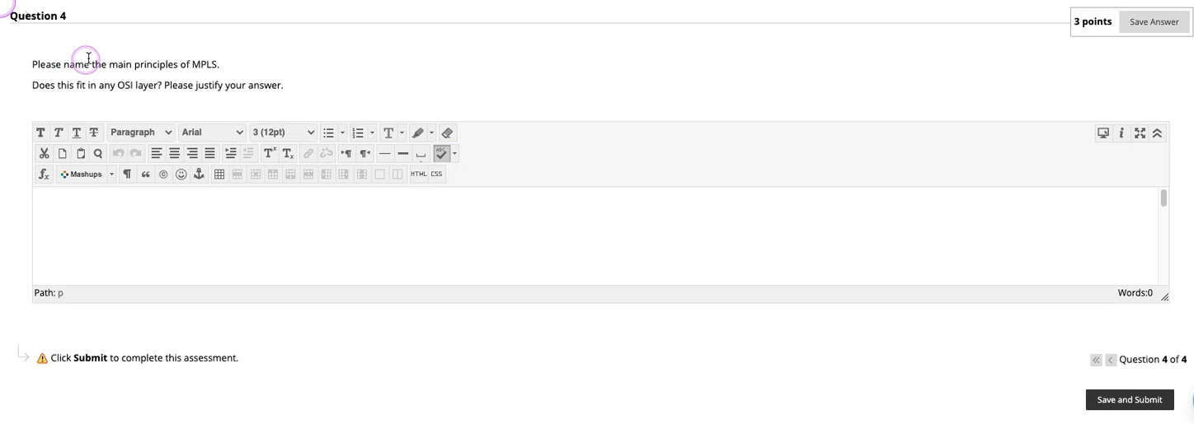
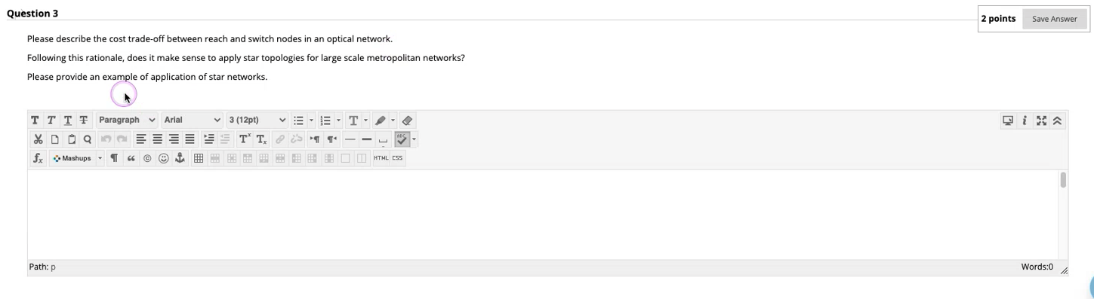
Example questions

Slide 14
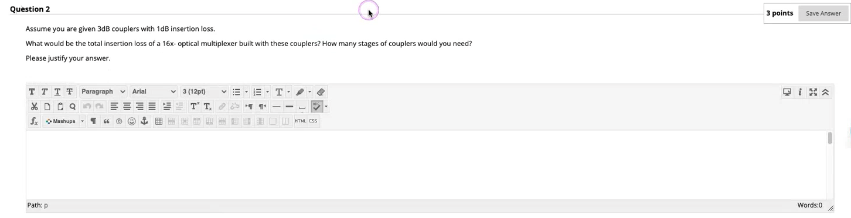
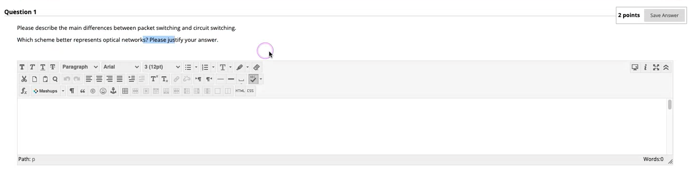
Example questions

